Slide 1
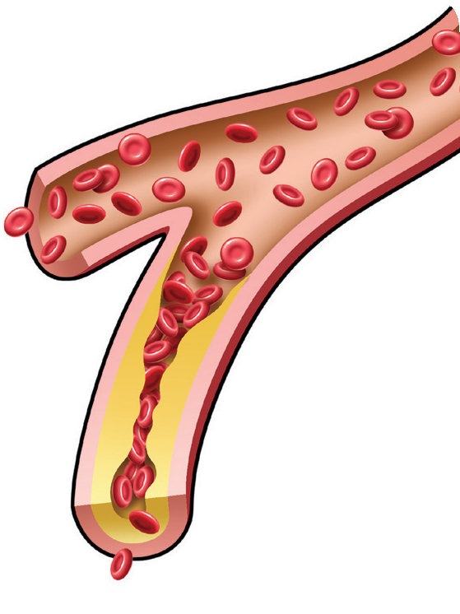
Lipids—What Are They?
When blood vessels, such as arteries, get blocked by lipids (LDL), it is hard for blood to move through the blood vessels.
If an artery in the heart gets completely blocked, then your heart does not get the oxygen it needs and angina or heart attack may occur.
What are triglycerides?
Triglycerides are fats that your body stores for later use as energy. They are produced in the liver and can increase with obesity, smoking, lack of physical activity, and high alcohol and high carbohydrates in your diet.
Taking care of lipids every day
Talk to your provider about changes that may help lower your risk of heart disease.
Follow a healthy diet that is low in fat.
Start a regular exercise program.
If you smoke, ask about ways you can quit.
Try to lose weight and keep it off.
Take your medicine or supplements as directed.
When possible, reduce stress in your life.
Lipids are fats found in your blood. Cholesterol and triglycerides are two types of lipids. Here are some things you should know.
What is cholesterol?
Total cholesterol is the amount of all cholesterol in your blood.
LDL cholesterol is the “bad cholesterol” that sticks to your blood vessels and blocks blood flow.
HDL cholesterol is the “good cholesterol” that prevents cholesterol from sticking to your blood vessels.
What can happen when you have too much cholesterol?
Your body needs some cholesterol, for making hormones and other substances, but you can have too much. When you have too much cholesterol, it can build up on the walls of your blood vessels and lead to higher risk for heart disease.
Blood brings needed oxygen to your heart.
Normal blood vessel flow
High cholesterol and other fats reduce blood flow

Slide 2
Keep track of your lipid numbers in the chart below. Compare your numbers with the chart on the left. Ask your provider what your goal numbers should be.
Date Result Goal
My Numbers—Ask About Each One
These are general guidelines for adults
Total Cholesterol (mg/dL) |  | What It Means
Less than 200 |  | Desirable
200-239 |  | Borderline high
240 and above |  | High
Total Cholesterol
LDL Cholesterol
HDL Cholesterol Triglycerides
LDL Cholesterol (mg/dL) | What It Means
Less than 100 | Very good
100-129 | Good
130-159 | Borderline high
160-189 | High
190 and above | Very high
Along with high lipid levels, there are many other risk factors for
heart disease. As the chart shows, you can help manage many of
HDL Cholesterol (mg/dL)
What It Means
these risk factors.
60 and above
May protect against heart disease
Risk Factors You Can’t Control
Risk Factors You Can Help Manage
Less than 40
Major risk factor for heart disease
Age
You are a man age 45 or older
You are a woman age 55 or older
High cholesterol and triglycerides
Triglycerides (mg/dL)
What It Means
High blood pressure
Less than 150
Normal
Family History
Your father or brother had heart disease before age 55
Your mother or sister had heart disease before age 65
Diabetes
150-199
Borderline high
Being overweight or obese
200-499
High
500 and above
Very high
Cigarette smoking
Lack of exercise

Slide 3
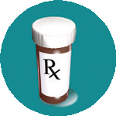
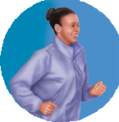
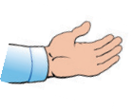
4
l
a
o
G
My Lipid Goals—What Are They?
You are the most important person in managing your lipid numbers. Talk with your provider to help you choose one or more goals you are ready to work on now.
Medicine
I will take my lipid-lowering medicine(s) as directed by my provider.
I will call my provider if I have problems.
I will ask questions when I do not understand.
1
l
a
o
5
G
l
a
o
G
Diet
I will eat a heart-healthy diet that is low in salt and fat. I will keep track of what I eat.
I will try to lose pounds by my next provider visit.
I will limit the amount of alcohol I drink, as directed by my provider.
#s
Know My Numbers
I will have my levels checked as directed by my provider. I will work to reach my lipid goals:
Total cholesterol LDL cholesterol HDL cholesterol
2
l
a
6
o
l
Triglycerides
a
G
o
G
Exercise
I will exercise for minutes days per week, as directed by my provider.
My provider and I agree that the best activities for me are .
If I notice chest pain, shortness of breath, or chest tight- ness, I will get emergency help.
Provider Visits
I will keep my provider appointments even when I feel fine.
I will ask my provider questions when I do not understand something.
7
l
a
o
G
Help From Others
3
l
a
o
G
I will talk with family and friends about how having high cholesterol makes me feel.
I will consider joining a support group.
I will let my provider know if I feel moody, blue, or stressed.
Smoking
I will think of all the reasons why I should quit smoking.
I will ask my provider about how I can quit smoking and then take the steps to quit.
If I start smoking again, I will try to quit again.
Stillwater Family Care

Slide 4
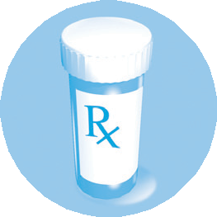
Lipid-Lowering Medicines— How Do They Work?
A healthy lifestyle may not be enough to help manage your lipids. Your provider may ask you to take medicine or a dietary supplement.
Over time, you may need more than one kind of medicine to help manage your lipid levels. It may take a while before these medicines take effect. Even when you reach your lipid goals, you may need to keep taking your medicines for a long time.
Not every medicine is right for everyone. It is important to talk with your provider at each visit about your lipid levels and medicine.
Statins
Reduce the amount of cholesterol made in your body.
Mainly used to lower LDL (bad) cholesterol.
q
(name of your medicine)
Cholesterol absorption inhibitors
Slow down how quickly your body absorbs cholesterol.
Mainly given to lower LDL (bad) cholesterol.
q
(name of your medicine)
Bile acid resins
Used to lower LDL (bad) cholesterol.
q
(name of your medicine)
Niacin
Given to lower triglycerides and LDL (bad) cholesterol and to raise HDL (good) cholesterol.
q
(name of your medicine)
Fibrates
Mainly used to lower triglycerides and raise HDL (good) cholesterol.
q
(name of your medicine)
Omega-3 fatty acids
May lower triglycerides in some patients.
q
(name of your supplement)
Other supplements
q
(name of your supplement)
Fill out a medicine chart with the help of your care manager. It is important to discuss this chart at every visit.

Slide 5
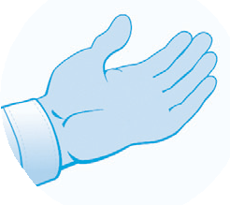
Managing Lipids—
Where Can I Go for Help?
I need help. I can’t do this on my own.
Ask a family member or friend to support you, such as going with you to your next provider visit.
Ask your provider to help you start a healthy diet. Your provider may also refer you to a dietitian.
Ask your provider about a support group.
“
“
For more help and information, contact one or more of these resources:
American Heart Association (AHA)
800-AHA-USA-1 (800-242-8721)
www.americanheart.org
National Heart, Lung, and Blood Institute Information Center
301-592-8573
www.nhlbi.nih.gov
The resources listed above are administered by independent third parties not affiliated with or endorsed by GlaxoSmithKline. GlaxoSmithKline is not responsible for the content of these resources.
If you have trouble paying for your medicine:
Visit www.togetherrxaccess.com, www.gskforyou.com, or www.PPARx.org for more information.
Another option is to call 800-Medicare (800-633-4227), or visit www.medicare.gov.
To learn more about what may be getting in the way of taking your medicine, go to www.HealthCoach4Me.com.
Have you felt moody or blue?
It is common for people with chronic conditions, such as high cholesterol and triglycerides, to feel moody or blue from time to time. If these feelings continue, you may lose interest in the things you used to like to do. Or you may have problems sleeping or working. The good news is that you don’t have to deal with these feelings by yourself. Talk with your family, friends, and provider for help.

