Slide 1

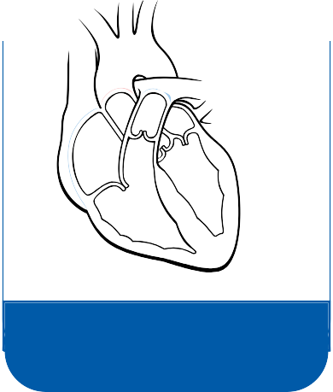










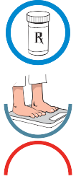
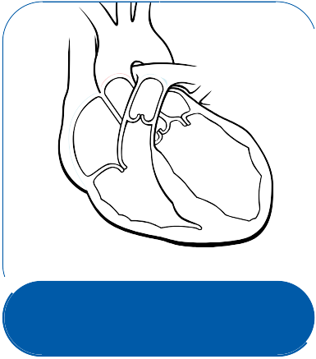











Heart Failure—What Is It?
What does heart failure feel like?
Patients with heart failure may experience some of these symptoms but not necessarily all of them.
Shortness of breath
Heart failure does not mean your heart stops working.
It occurs when the heart is unable to pump enough blood to meet the body's needs. Your heart must work harder to keep blood moving through your body.
There are things you can do to help manage heart failure.
What causes heart failure?
Faster heartbeat
Feeling extra tired
Swollen ankles, legs, or belly
Weight gain (from fluid)
Cough
Over time, fluid may leak into your lungs (congestive heart failure) and cause breathing problems.
A healthy heart pumps oxygen-rich blood (red) throughout your body.
Trouble sleeping because of shortness of breath
Taking care of heart failure every day
Currently there is no cure for heart failure. But there are ways to help manage it:
Take your medicine as directed by your provider.
Keep your weight in a healthy range.
Eat foods that are low in salt and low in fat. If you smoke, quit.
Get regular, moderate exercise if your provider approves.
In heart failure, the weakened heart cannot pump as strongly. There are many things that can overwork and affect your heart and lead to heart failure over time. They may include:
High blood pressure
Heart attack
Coronary artery disease
Diabetes
Injury to the heart or
a birth defect
Lung disease
Untreated thyroid disease
In heart failure, the weakened
heart cannot pump as strongly.
Radiation/chemotherapy for cancer

Slide 2

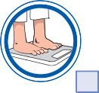










My Heart Failure Goals— What Are They?
Attitudes and Beliefs
5
l
a
o
G
Smoking
I will think of all the reasons I should quit smoking.
I will ask my provider about how I can quit smoking and then take the steps to quit.
If I start smoking again, I will try to quit again.
You are the most important person in managing your heart failure. Talk with your provider to help you choose one or more goals you are ready to work on now.
Weight
I will weigh myself every day at the same time, using the same scale.
I will try to reach and/or stay at my goal body weight of .
I will call my provider if I gain weight for straight days or gain more than pounds in a day.
Symptoms
I will check my feet and ankles every day for signs of swelling.
I will call my provider if any of my symptoms get worse.
Medicine
I will take my medicine(s) as directed by my provider. I will call my provider if I have problems.
I will ask questions when I do not understand.
6
l
1
a
l
a
o
o
G
G
Alcohol
I will limit the amount of alcohol I drink, as directed by my provider.
Diet
I will follow an appropriate diet based on my provider’s instructions.
I will drink glasses of fluid a day.
7
l
a
o
G
2
l
a
o
G
8
l
a
o
G
Sodium (Salt) Use
My daily sodium goal will be
9
mg per day.
l
3
a
l
o
a
o
G
G
Exercise
I will exercise for minutes days per week as directed by my provider.
My provider and I agree that the best activities for me are
4
l
a
o
.
G
Rest
I will get enough rest at night and take breaks during the day if I need them.
If I have trouble sleeping, I will call my provider.
EMERGENCY: Get emergency medical help right away if you think you are having symptoms of a heart attack, which may include: 1) Chest pain or discomfort; 2) Upper body (ie, shoulder, arm, jaw) discomfort that is not relieved with nitroglycerine or rest; 3) Shortness of breath; 4) Cold sweats, nausea, or light-headedness.
6
7

Slide 3



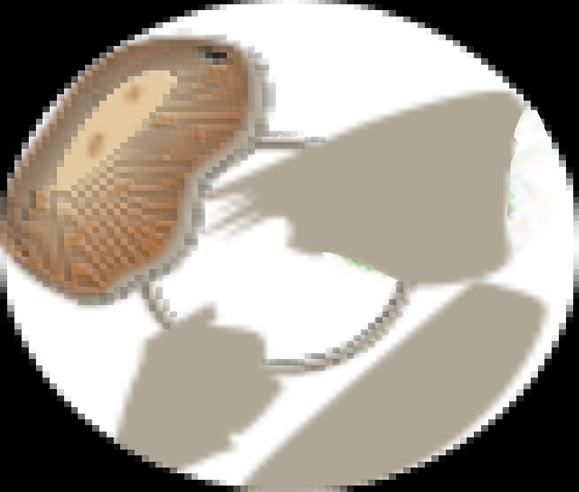









Heart Failure Medicines— How Do They Work?
What you can do
There are several types of medicine for heart failure. You may need more than one medicine to manage your heart failure.
Heart failure medicine can:
Help improve symptoms
Help reduce the need for hospitalization
ACE inhibitors block harmful stress hormones, which widens blood vessels
  ACE inhibitors make it easier for the heart to pump blood through your body.
Angiotensin II receptor blockers (ARBs)
  Widen blood vessels, like ACE inhibitors, by blocking the narrowing effects of certain hormones on blood vessels. The vessels widen and blood pressure goes down.
Beta-blockers help reduce the work your heart has to do
  Beta-blockers keep the heart from beating too fast.
Diuretics, or “water pills,” help your body get rid of extra fluid and sodium
  Diuretics can help you breathe easier. They also reduce the swelling in other parts of your body (for example, feet and lower legs).
Digoxin, or digitalis, helps your heart pump more strongly.
Weigh yourself daily. If your weight goes up, you may have excess water. Keep a daily record of your weight.
Use less salt. Your provider may suggest a low-salt diet. Eating salt makes the body retain water.
Eat a healthy, balanced diet. Eating well may help you stay at a healthy weight.
Stay active. Physical activity may make your muscles stronger. This may help you feel better and do your daily tasks more easily.
Don’t smoke. If you smoke, talk to your provider about a program to help you quit.
Avoid alcohol. Too much alcohol may worsen high blood pressure and heart failure. Alcohol is also high in calories.
Get plenty of rest. Take breaks during the day if you need them.
May help you breathe easier.

Slide 4

My Medicines—Am I Taking Them As Directed?
Mark medicine refill dates on a calendar.
Use reminder notes to remember to take your medicine.
Talk to your provider if you have questions about your medicine or how to take it.
Fill out a medicine chart like the one below and talk with your provider. This may help you take the right dose at the right time. Include all medicines that you take for all reasons.
Date Started
Name and Strength of Medicine
How Much I Take
When I Take It
I Take It For
What My Pill Looks Like
Dates to Refill Rx
Special Instructions

Slide 5
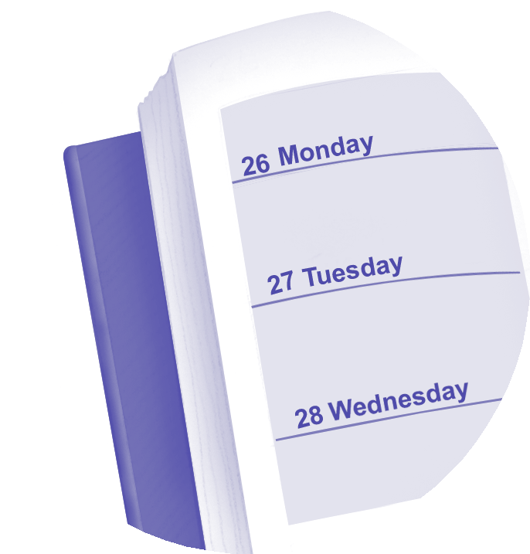
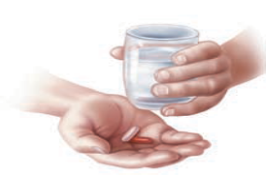
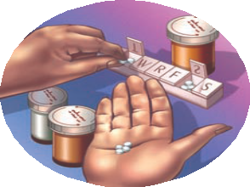

Sticking With My Medicine— What Will Work?
If you often forget to take your medicine:
Use a pill box marked with the days of the week. Take it with you when you are away from home.
Wear a watch. Set an alarm. Leave yourself a note on the bathroom mirror.
Keep your medicine in a place where you will see it every day.
Taking your heart failure medicine as directed by your provider is one of the most important things you
can do to help manage your heart failure.
Not taking your heart failure medicine as directed by your provider means:
Your medicine may not work the way it should.
You may have trouble doing daily tasks.
Your heart failure symptoms may get worse.
You may need to go to the hospital.
If you forget to refill your medicine on time:
Write “refill medicine” on your calendar about a week before your medicine will run out.
Make sure you have enough refills to last until your next provider visit.
Ask your pharmacy to send you reminders to refill your prescription.
Taking more than one medicine at different times each day can be hard. The key is to create a routine that fits your life:
Try taking your medicine around the same time as other daily habits, such as in the morning when brushing your teeth or in the evening around dinnertime.
Ask your provider if there is a medicine you can take less often. A simpler medicine schedule may help you.
“
“
I’m feeling better. Why do I need to take all these medicines?
Taking your medicine every day may be why you feel better. If you skip your medicine, your symptoms may return or become worse. T

Slide 6
Watching My Symptoms— How Do I Take Charge?
Taking your medicine the right way is one of the most important things you can do to help manage your heart failure. Ask your provider to help you fill out your plan. A plan can be very helpful, especially when your symptoms get worse.
Call your provider if you notice ANY of the following:
Weight gain of 2 or more pounds in a day or 4 pounds in a week
Increased swelling in ankles, legs, or belly
Increased shortness of breath, especially when lying flat (for example, you may have to sleep sitting up)
Extreme tiredness
A cough that won’t go away; or coughing up pink mucus Heartbeat is very fast
You feel your heart is skipping beats Feeling restless, dizzy, or woozy Nausea or lack of appetite
Date:
/
/
Provider/Phone:
Emergency number: Target weight:
Target blood pressure:
Action:
Take medicine as directed by your provider.
Check your weight every day and write it down.
Follow a low-salt diet and limit alcohol, as directed by your provider.
Get regular physical activity if your provider approves. Check your blood pressure if instructed to.
If you smoke, quit.

Slide 7





Stay Active
Talk to your provider about a regular exercise plan. It can help you:
Build your muscle and bone strength
Healthy Eating and Activity— How Can They Help?
Eating Right
Eating right is one way to help you take charge of your health. It may also give you more energy.
Eat more fresh fruits and vegetables and
fewer fatty foods. This may help you keep to your goal weight.
Cut out salty foods. This may keep you from holding on to extra water.
Ask your provider how much fluid to drink each day.
Make it easier to do daily activities
Improve your mental health and mood
Control your weight
Exercise Tips
Your provider can help you create the right exercise plan based on your health.
Find exercise that you like to do. Your provider can tell you how much exercise to get and which activities to avoid.
Start off slowly (warm up) and work up to exercising for 20-30 minutes most days of the week, then cooling down a bit before completely stopping.
Stop exercising right away and call your provider if you feel:
  Pressure or pain in your chest, neck, arm, jaw, shoulder
  Dizzy, light-headed, or nauseated
  More short of breath or tired than usual
  Your heartbeat is too fast or too slow, or is skipping a beat
Tips for cutting out salt:
Take the salt shaker off the table and don’t add salt when cooking, baking, or eating.
Use pepper and salt-free spice blends to give
food flavor. Try adding lemon juice, garlic, and herbs.
Avoid processed foods. Some canned soups have almost one half of your daily sodium limit in just one serving.
Read food labels to see how much sodium is in each serving.

Slide 8
Watching My Weight— Weight Record
My Target Weight Is:
If you gain a lot of weight or gain weight very quickly, it may be a sign of fluid buildup. Your provider may need to change your treatment. So keep track of your weight daily with this weight record. Weigh yourself each morning at around the same time.
Date Weight Date Weight
Date
Weight
Date
Weight

Slide 9
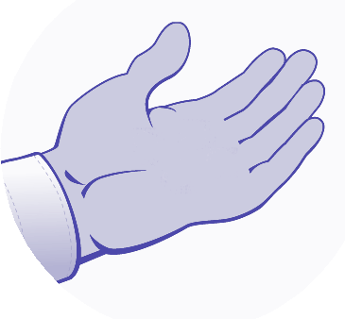
Heart Failure Support— Where Can I Go for Help?
“
“
I need help. I can’t do this on my own.
Ask a family member or friend to support you, such as going with you to your next provider visit.
Ask your provider about a heart failure support group. You can find a group in your area at www.americanheart.org.
For more help and information, contact one or more of these heart failure resources:
American Heart Association (AHA)
800-AHA-USA-1 (800-242-8721)
www.americanheart.org
National Heart, Lung, and Blood Institute Information Center
301-592-8573
www.nhlbi.nih.gov
Heart Failure Society of America
651-642-1633
www.hfsa.org
If you have trouble paying for your medicine:
Visit www.togetherrxaccess.com, www.gskforyou.com, or www.PPARx.org for more information.
Another option is to call 800-MEDICARE (800-633-4227), or visit www.medicare.gov.
To learn more about what may be getting in the way of taking your medicine, go to www.HealthCoach4Me.com.
Have you felt moody or blue?
It's common for people with chronic conditions, such as heart failure, to feel moody or blue from time to time. If these feelings continue, you may lose interest in the things you used to like to do. Or you may have problems sleeping or working. The good news is that you don't have to deal with these feelings by yourself. Talk with your family, friends, and provider for help.
The resources listed above are administered by independent third parties not affiliated with or endorsed by GlaxoSmithKline. GlaxoSmithKline is not responsible for the content of these resources.

